Slide 1
Secure Modem
Hardware Design – Audio Codec

Slide 2
Contents
Audio Codec Block Diagram
Audio Codec Algorithm
Audio Codec Selection
Summary
Discussion

Slide 3
Audio Codec Block Diagram

Slide 4
Audio Codec Block Diagram
The vocoder can be configured to transmit and receive digitized speech to and from most linear, a-law, or u-law audio codec
The 16-bit linear audio codec are preferable over an a-law and u-law companding chips
Notes:
Notes:
Companding (Compression and Expanding)
The 16-bit linear audio codec is preferable because the a-law and u-law chips are already incorporating some compression to reduce the number of bits per sample
Using a-law or u-law chips may reduce the overall voice quality, generated by the modem
Source:
AMBE-3000F_manual.pdf

Slide 5
Audio Codec Algorithm
a-law
u-law
linear

Slide 6
A-law
An ITU standard for converting analog data into digital form using Pulse Code Modulation.
It uses a companding technique that provides more quantizing steps at lower amplitude (volume) than a higher amplitude.
It is used in European 8-bit PCM digital communication systems
Notes:
Source:
http://encyclopedia2.thefreedictionary.com/A-law+algorithm
http://en.wikipedia.org/wiki/A-law_algorithm

Slide 7


A-law 1
A-law compression
A-law expansion
$$F\left(x\right)=sgn(x)\left\{\begin{matrix}\frac{A\left|x\right|}{1+ln⁡(A)}, \left|x\right|<\frac{1}{A} \\ \frac{1+ln⁡(A\left|x\right|)}{1+ln⁡(A)},\frac{1}{A}≤\left|x\right|≤1\end{matrix}\right.$$
Common A value=87.7
$$F^{−1}\left(y\right)=sgn(y)\left\{\begin{aligned}\frac{\left|y\right|(1+ln⁡(A))}{A}, \left|y\right|<\frac{1}{1+ln⁡(A)} \\ \frac{exp⁡(\left|y\right|\left(1+\ln\left(A\right)\right)−1)}{A}, \frac{1}{1+ln⁡(A)}≤\left|y\right|<1\end{aligned}\right.$$

Slide 8
U-law
It is a form of logarithmic quantization or companding
It is based on the observation that many signals are statistically more likely to be near a low signal level than a high signal level
Therefore, it makes more sense to have more quantization points near a low level than a high level
In typical system, linear samples of 14 to 16 bits are companded to 8 bits
Used in North America and Japan
Notes:
Source:
http://www.threejacks.com/?q=node/176

Slide 9

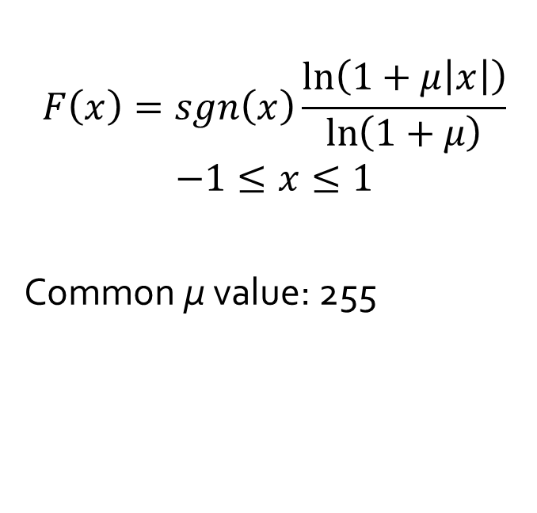
U-law 1
U-law compression
U-law expansion
$$F\left(x\right)=sgn\left(x\right)\frac{\ln\left(1+μ\left|x\right|\right)}{\ln\left(1+μ\right)}$$
$$−1≤x≤1$$
Common μ value: 255
$$F^{−1}\left(y\right)=sgn(y)(1/μ)({\left(1+μ\right)}^{\left|y\right|}−1)$$
$$−1≤y≤1$$

Slide 10
U-law 2
Exercise in MATLAB
Compare avg error of U-law companding and linear companding

Slide 11
Audio Codec Selection
Texas Instrument PCM3500
Texas Instrument TLV320AIC14

Slide 12
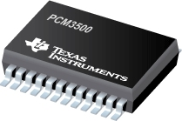
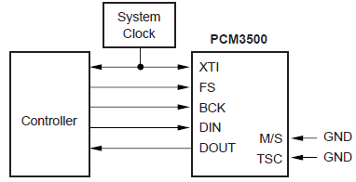
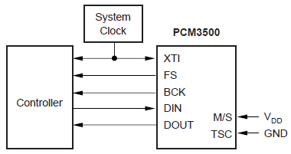
PCM3500
Features
16-bit ADC and DAC
Sampling Freq
7.2 to 26 kHz
2.7 to 3.6V power supply
Master or slave mode
TI PCM3500 Audio Codec
Slave Mode
Master Mode

Slide 13
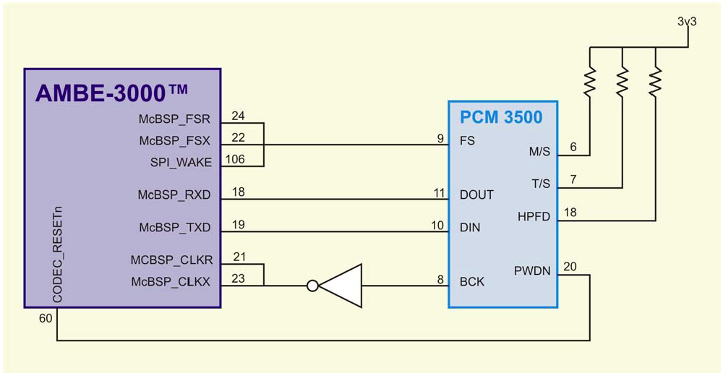
PCM3500 1
Interfacing with AMBE3000
Operated as Master
Using McBSP interface
Using 3.3V power supply
AMBE3000 and Audio Codec

Slide 14
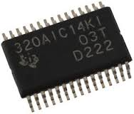
TLV320AIC14
Features
16-bit ADC and DAC
Sampling Freq
26kHz with IIR/FIR filter
104kHz without filter
1.7 to 3.6V power supply
TI TLV320AIC14 Audio Codec

Slide 15
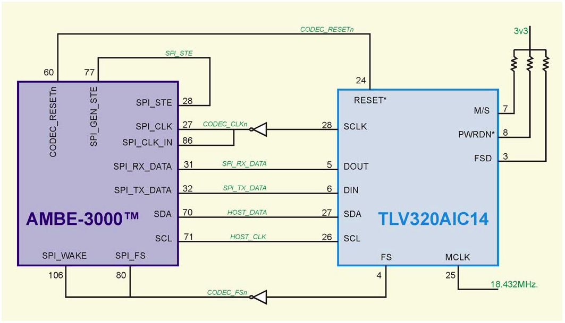
TLV320AIC14
Interfacing with AMBE3000
Using SPI interface
Using 3.3V power supply
Audio codec can be programmed via packet from AMBE3000
AMBE3000 and Audio Codec

Slide 16
Summary

Slide 17
Audio Codec
In order to process audio signal, vocoder need audio codec to digitized, analog audio
Audio codec performs companding (compression and expanding) to reduce size of digitized audio signal
Common companding algorithm:
Linear codec
A-law codec
U-law codec

Slide 18
Audio Codec 1
A-law and U-law codec have better performance than linear codec because have more quantization points near low level (where many signals are located)
However, for the vocoder, it is preferable to use 16-bit linear codec than either A-law or U-law codec, because they are lossy codec
They are two option of audio codec for AMBE3000:
PCM3500
TLV320AIC14 (suggested by reference design)

Slide 19
Discussion

